Slide 1
Gesture & Voice control PC

Slide 2
TOPICS COVERING
INTRODUCTION
OBJECTIVE
GESTURE ASSISTANCE
VOICE ASSISTANCE
WORKING PROCESS
CIRCUIT DIAGRAM
CONNECTION
FUTURE SCOPE
CONCLUSION

Slide 3
INTRODUCTION
OUR POINT OF VIEW
CONCEPT OF GESTURE AND VOICE CONTROL
COMPONENTS CAN BE USED
USAGE IN REAL WORLD

Slide 4
OBJECTIVE
Effortless Interaction
Convenient Use
Wireless Use
Easy to operate
Cost Effective

Slide 5
Gesture assistance
Browser
Swipe right and left to go to next and previous page respectively
Swipe Up and down for page up and down respectively.
Media Application
Swipe right and left to go to next and previous media respectively
PowerPoint
Swipe right and left to go to next and previous slide respectively
Volume
Move forward and backward from the sensor to control the system volume
Notes:
It isn’t coming soon .. it is already here and has been so for quite a while
Connects billions of sensors and devices from every day consumer objects to industrial equipment

Slide 6
Voice assistance
open xyz.com: Replace xyz with any website.
Send email/email: Follow up recipient’s name etc.
Current weather in (city name): Tell us the current weather of the city.
Hello: Greets user.
News for today: Reads top news of the day.
Play a song: Play song in you tube.
Time: Current system time.
Tell me about xyz: Tells about xyz Wikipedia.
Notes:
Provide intelligence
Improve efficiency

Slide 7
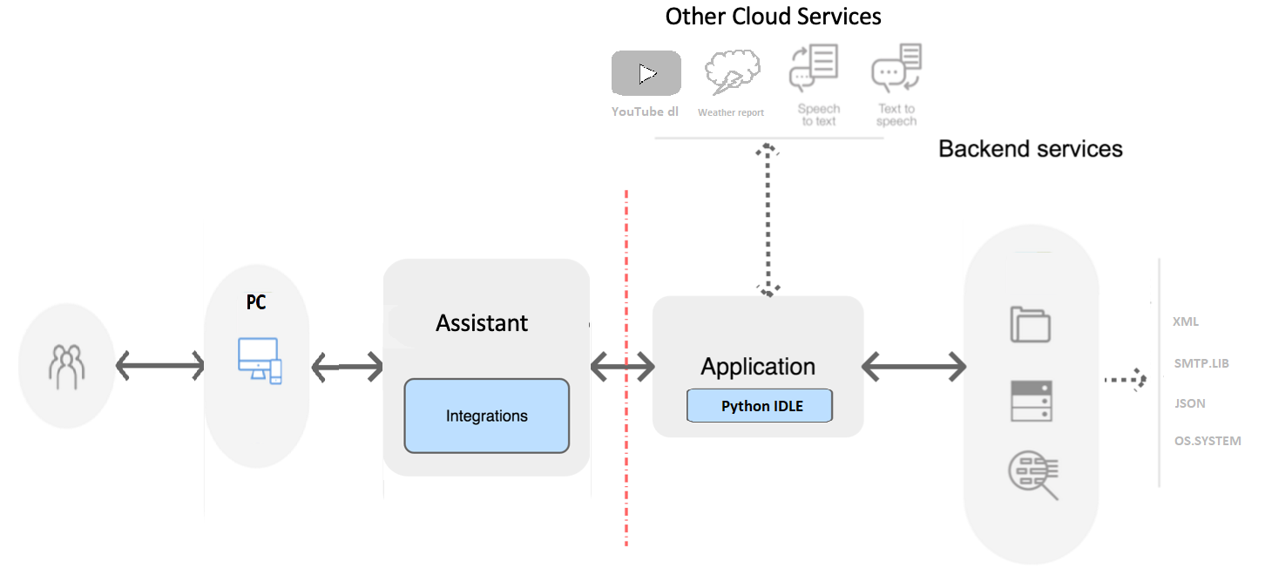
WORKING PROCESS OF VOICE

Slide 8
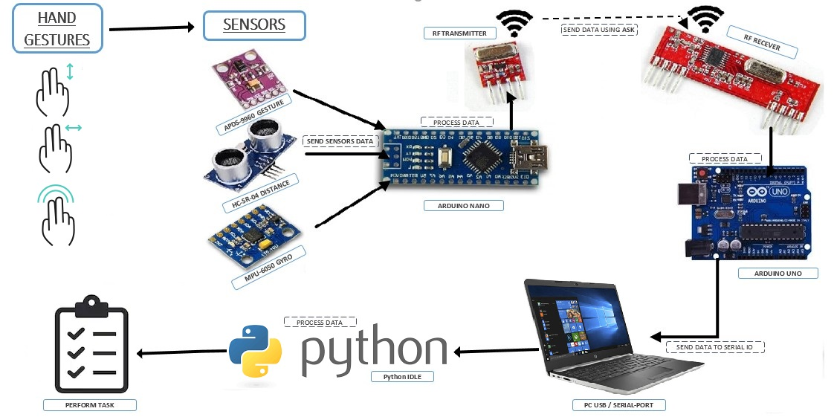
WORKING PROCESS OF GESTURE

Slide 9
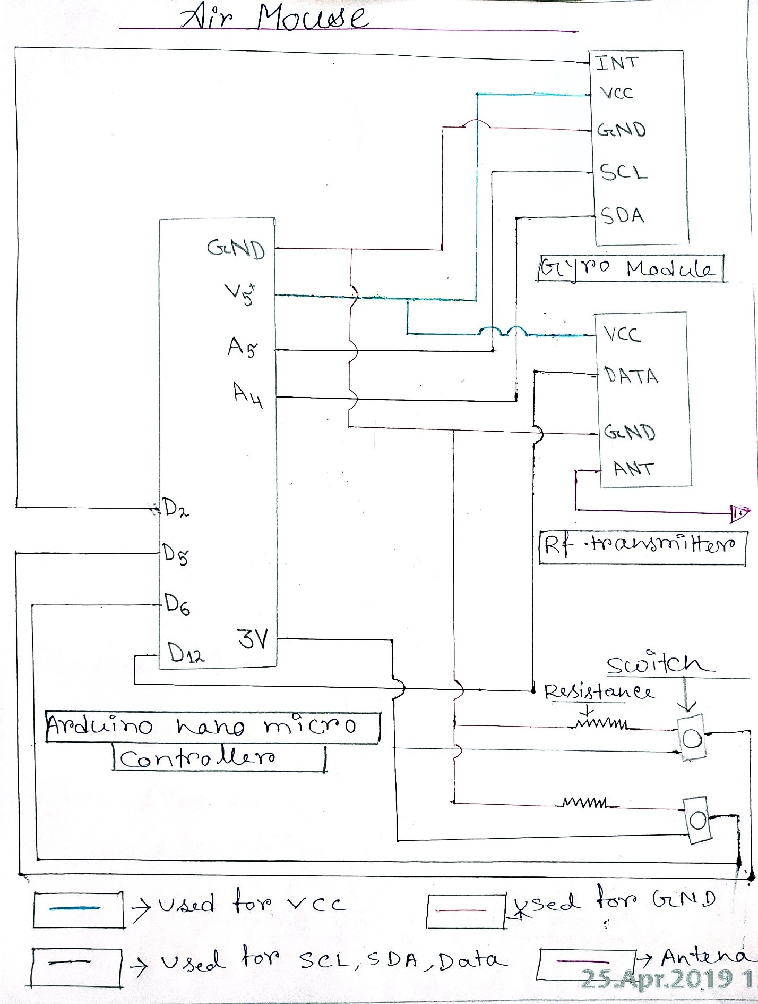
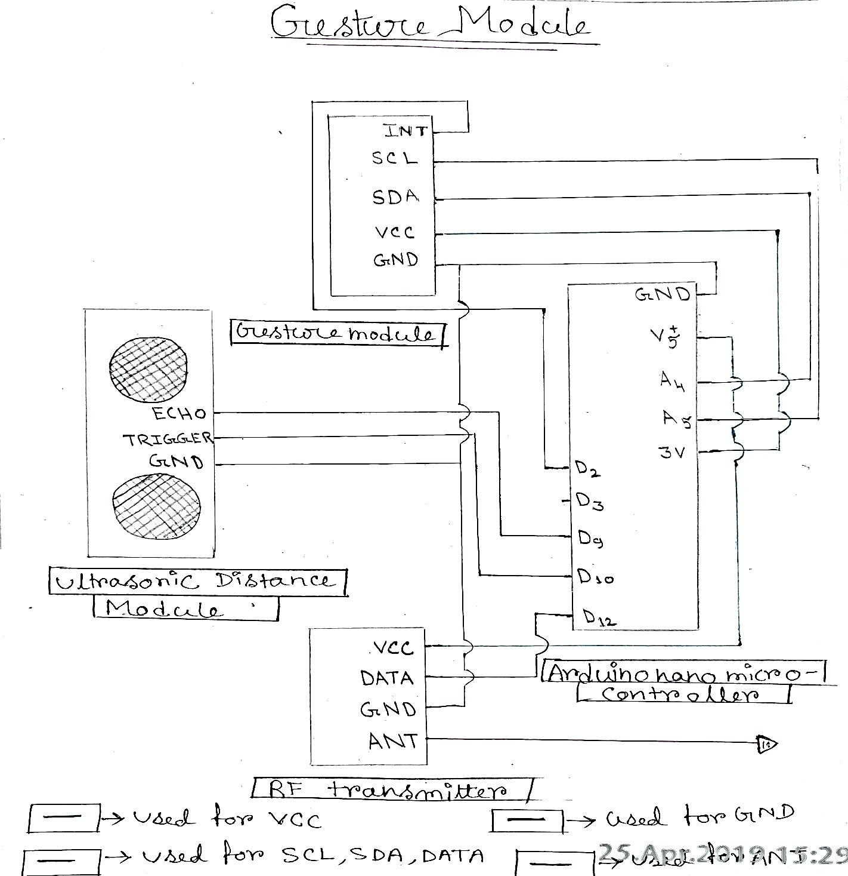
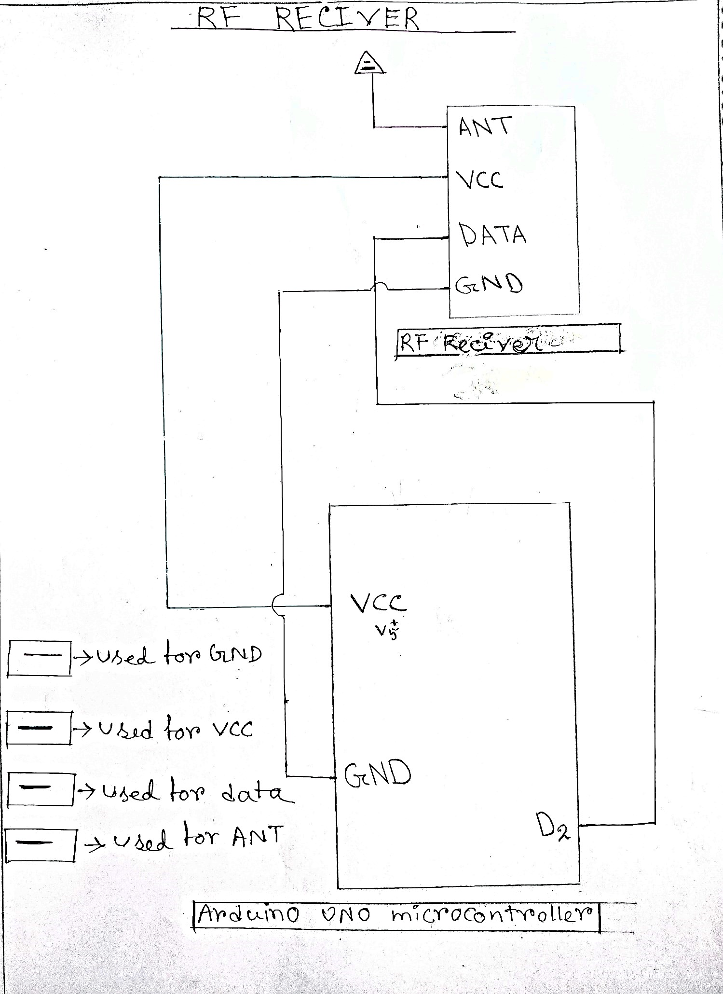
CIRCUIT DIAGRAM

Slide 10
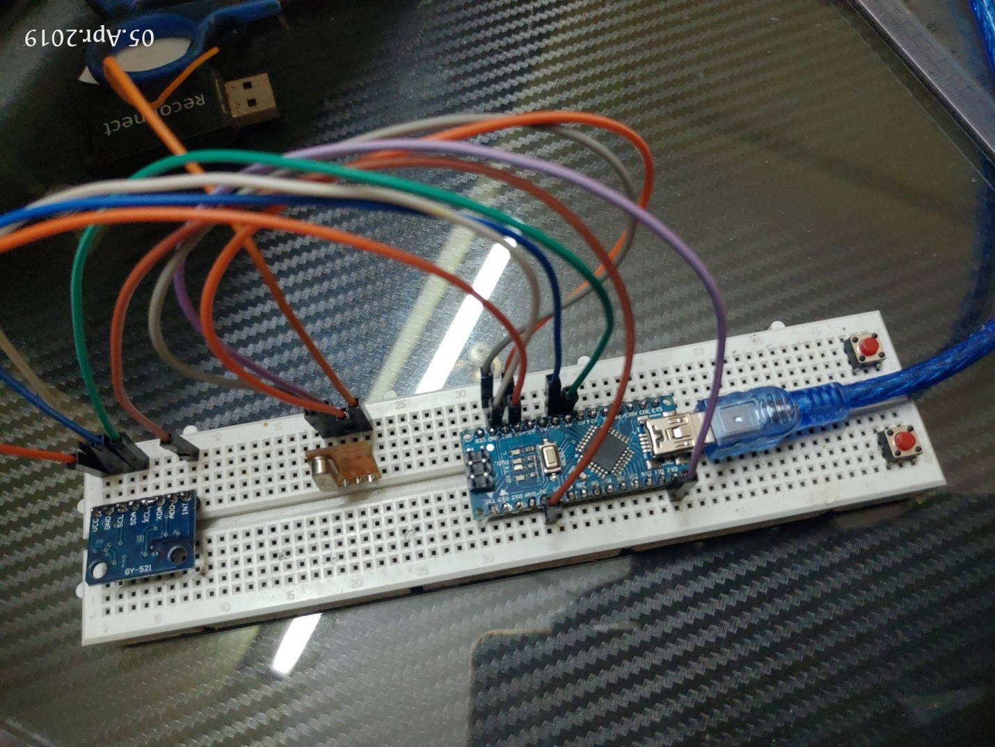
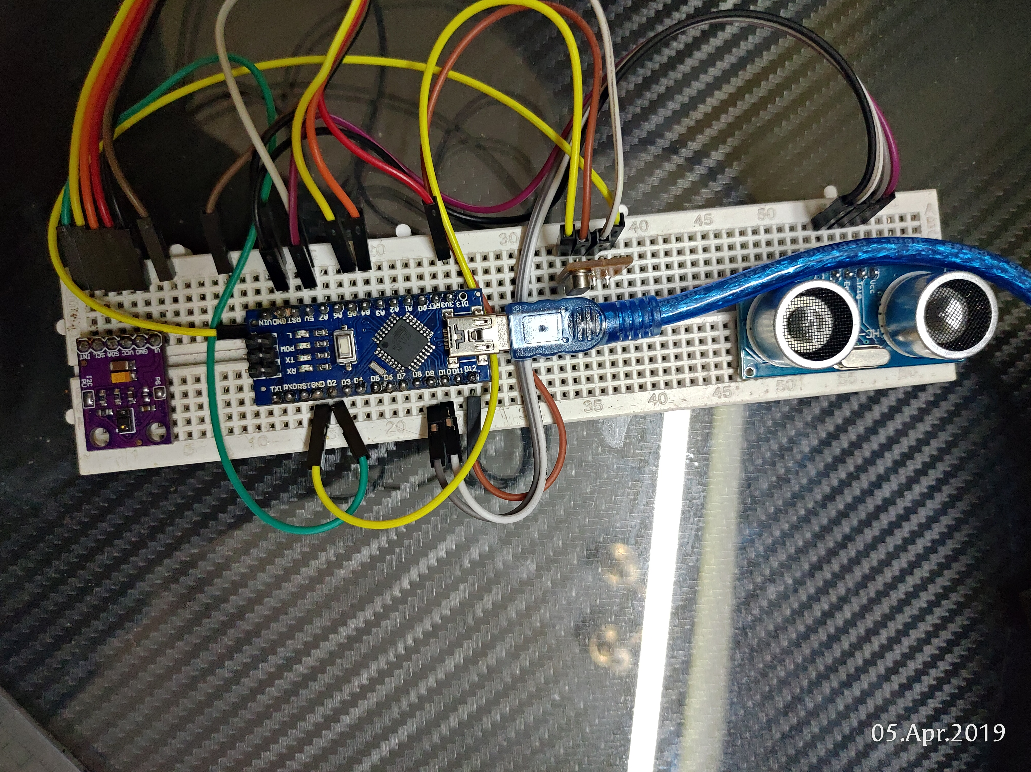
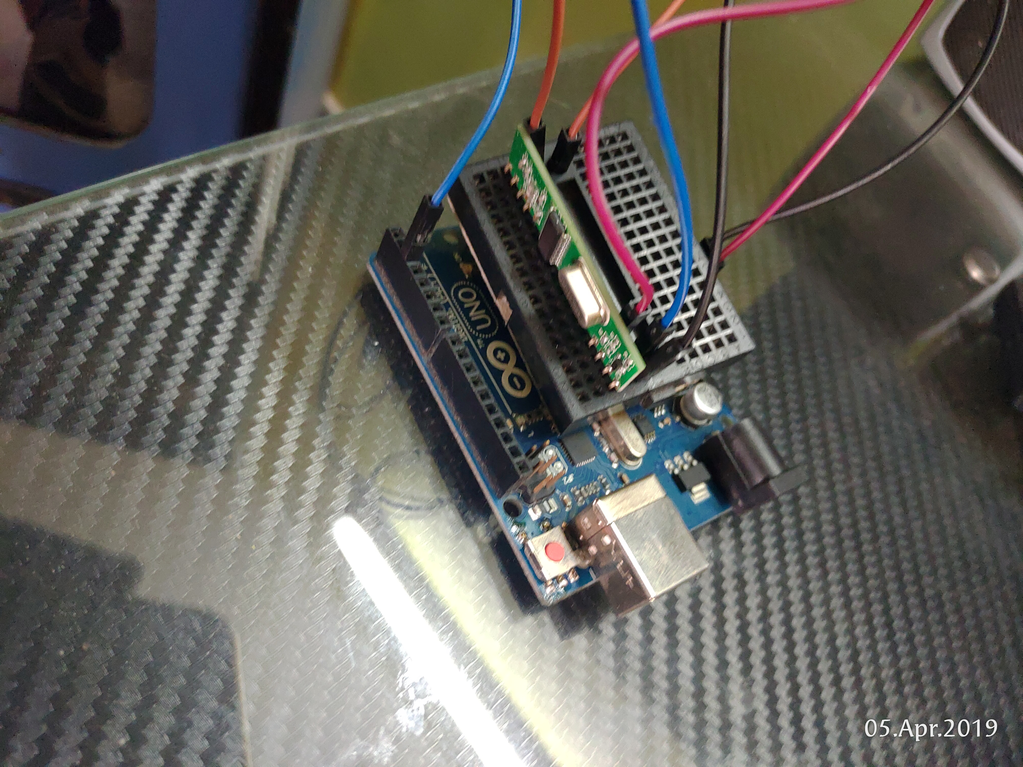
CONNECTION

Slide 11
FUTURE SCOPE
The user will get more smooth performance from the device which will be calibrated by us.
Drivers.exe file will be created for our project device.
For the betterment of security and reliability we will make our own servers to communicate the other devices.
We gradually enhance the device so that we can use it in gaming and virtual world in future.
We will made our project device an acceptable and proficient product.

Slide 12
CONCLUSION
FAST , EASY & CONVENIENT TO USE
LOW COST GESTURE & VOICE FEATURE
MINIMAL REQUIREMENT IS INTERNET
ACCSSIBLE VIA WIRELESS

Slide 13


